Slide 1

how’s your SIEM?
kimber duke
SAINTCON 2021
S2 Security

Slide 2
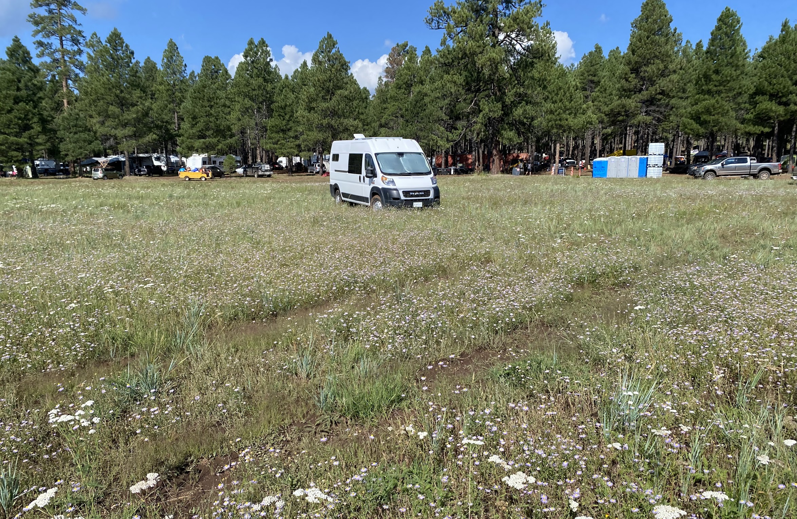

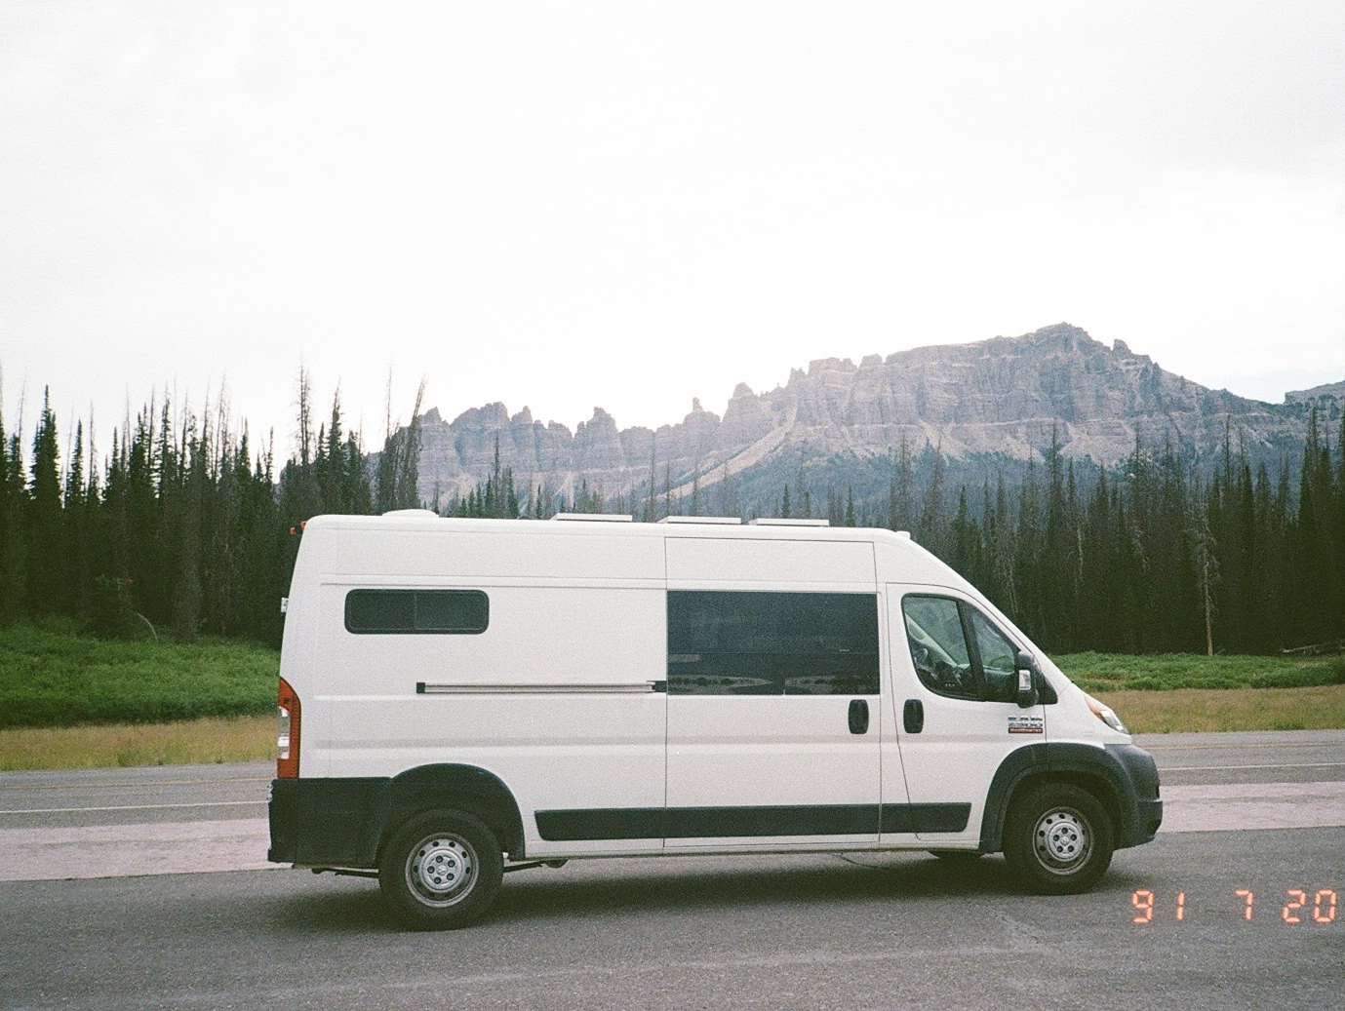
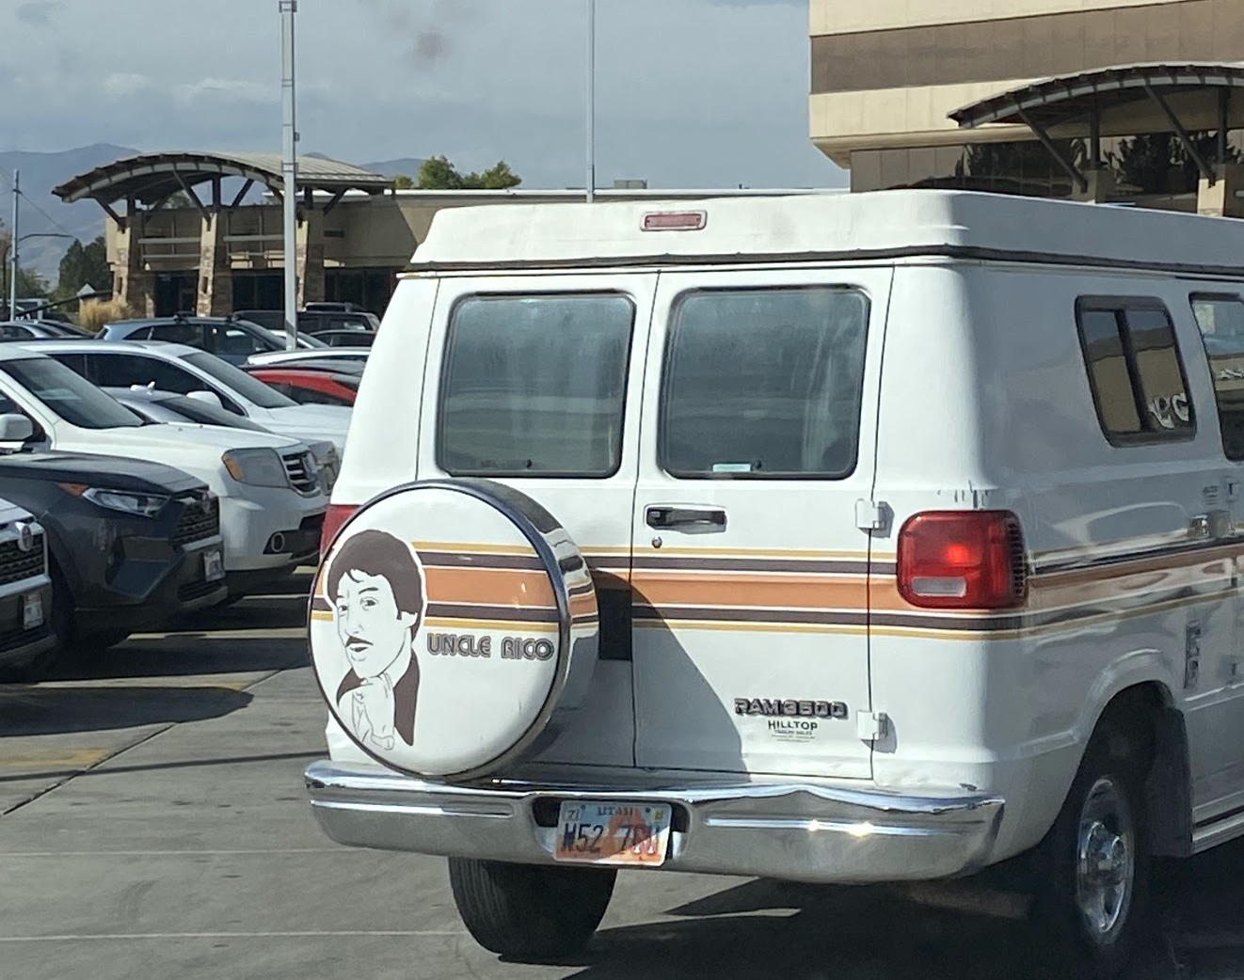
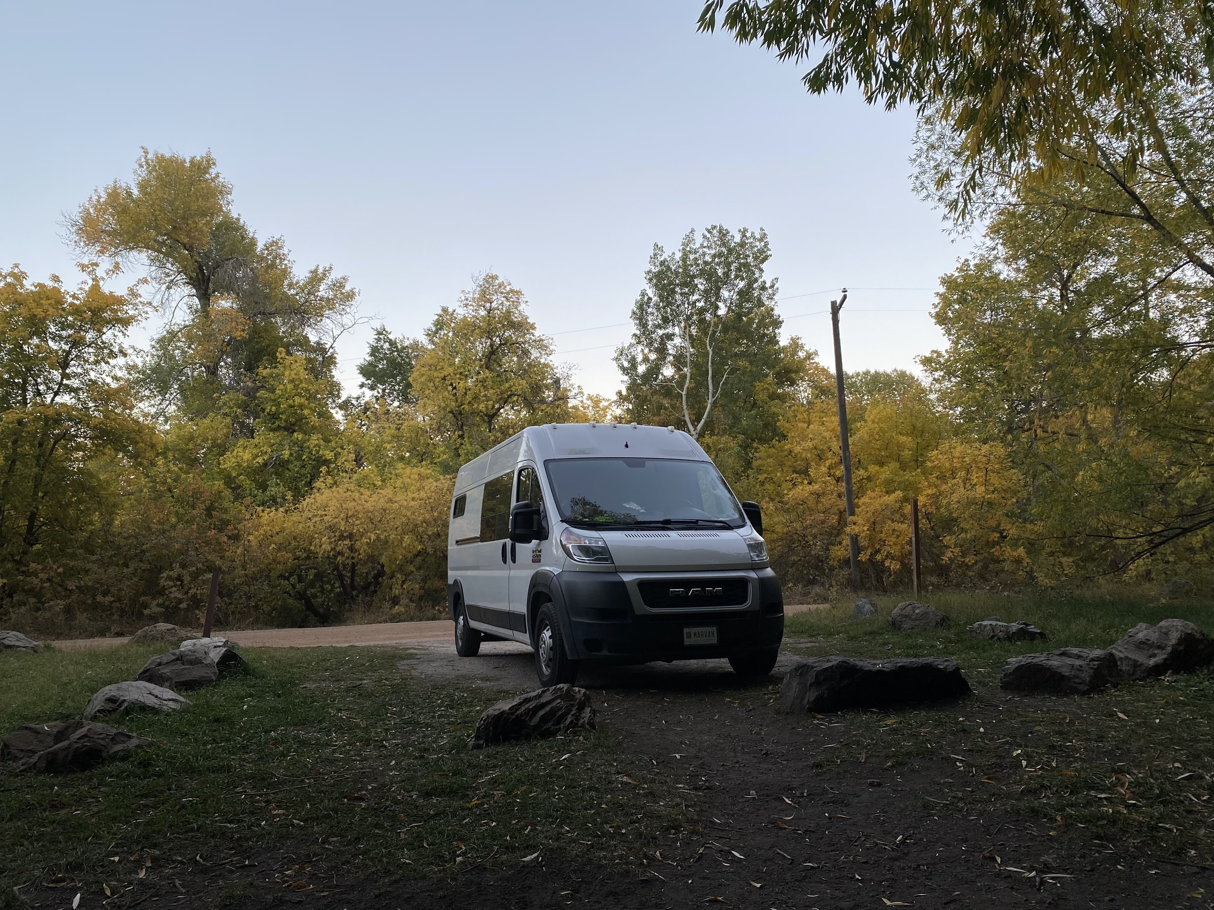

Slide 3
kimber, what is this talk about?
Making sure we all know what a SIEM is.
SIEM relationship issues.
What to do with your SIEM?
What’s the future for your SIEM?

Slide 4
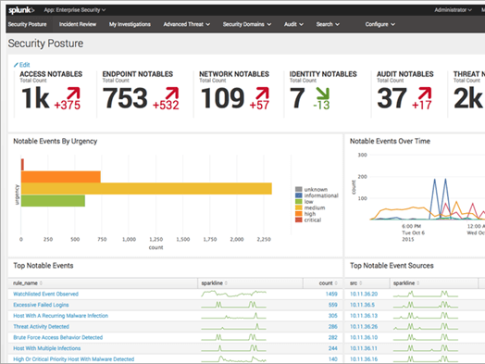
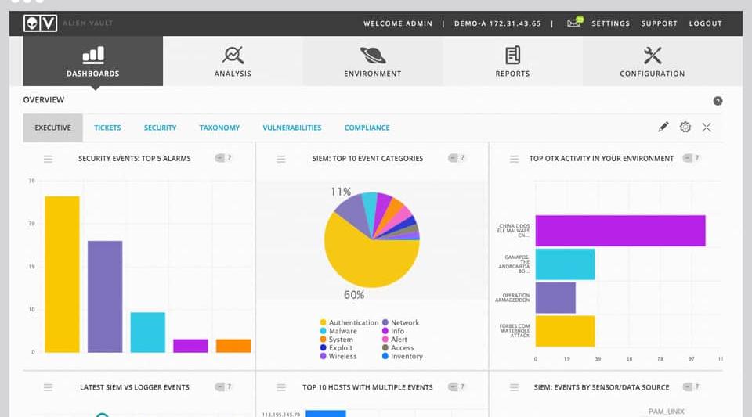
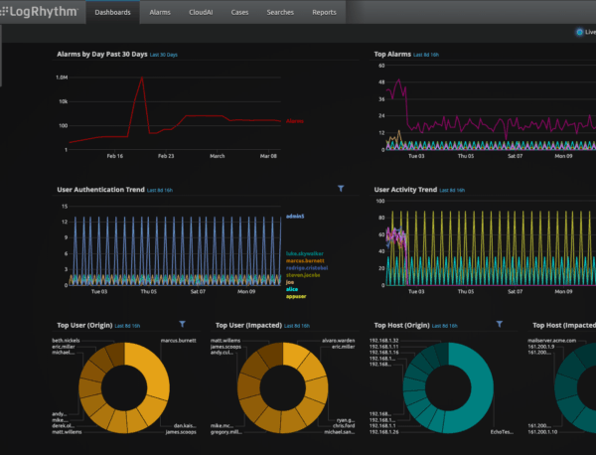
SIEM life

Slide 5
👎🏼PROBLEM😐: normalization is broken
Event name = vulnerability
Source IP = 129.xx.xx.21
Destination IP = 99.xx.xx.63
Port = 80
Protocol = web-browsing
vSys = vsys1
Jul 8 07:00:45 192.168.1.5 Jul 7 18:57:46 vulnerability, src_ip=129.xx.xx.21,dest_ip=99.xx.xx.63,translated_ip=107.21.226.21,port=80,,,protocol=web-browsing,vsys=vsys1,TRUSTED_LAN_L3,port=ethernet1/1
Source IP=”src_ip\= (?:[0-9]{1,3}\.){3}[0-9]{1,3})”
cloud
raw data
normalization
event log
✨SOLUTION✨
learn 2 normalize.

Slide 6
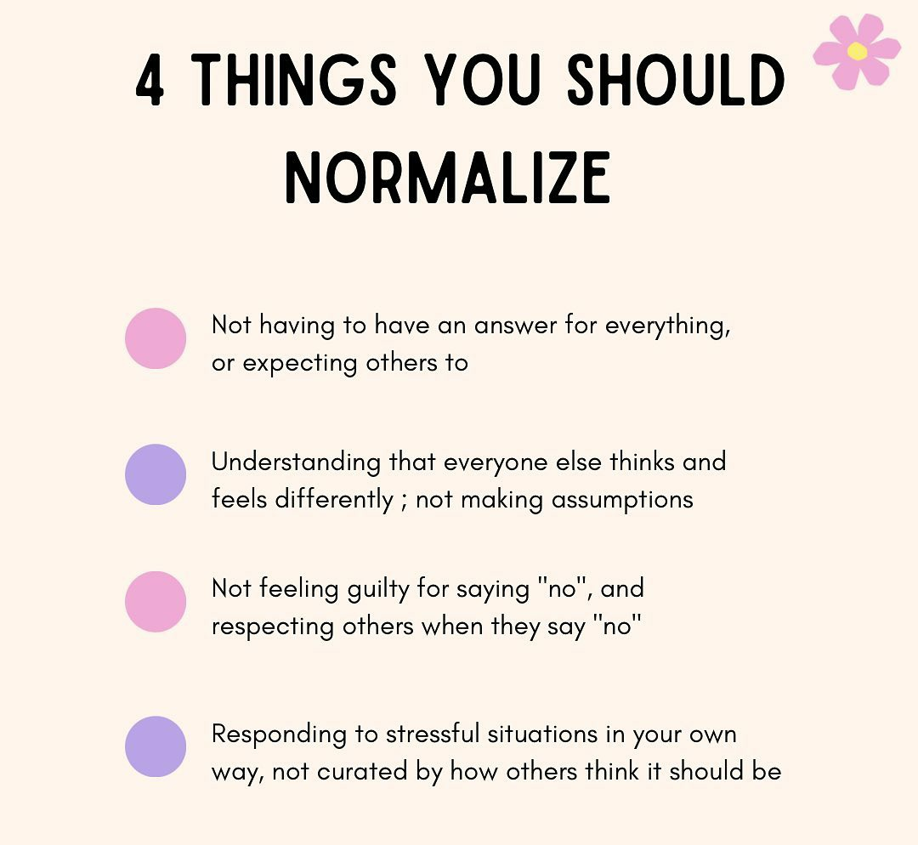
RESOURCES ON NORMALIZATION:
Ofer Shezaf – “Should we Normalize Security Data?” https://xiom.com/2021/07/01/should-we-normalize-security-data/
Azure Sentinel docs about normalization - https://docs.microsoft.com/en-us/azure/sentinel/normalization

Slide 7
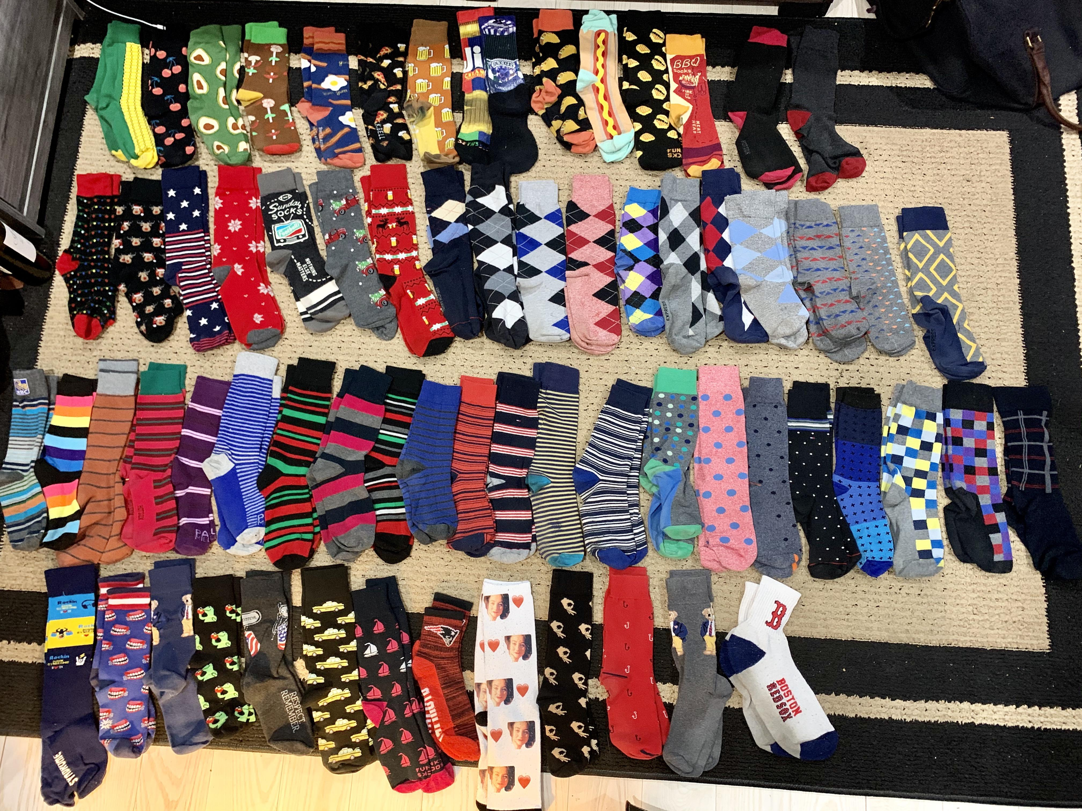
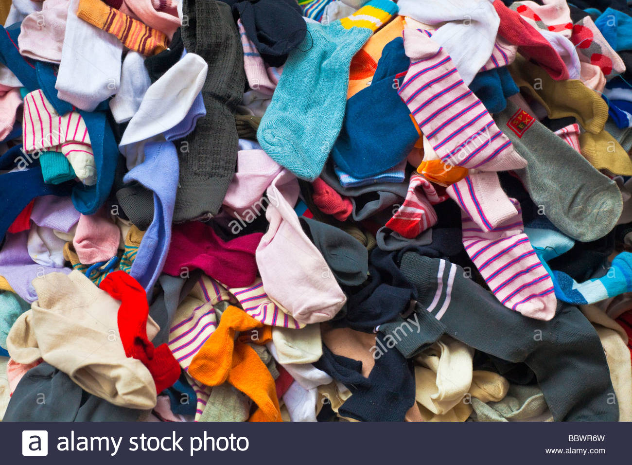
🙅🏻‍♂️PROBLEM🙅🏽‍♀️: You have so much data that anything good just disappears.
✨SOLUTION(S)✨
narrow down your favs
get back to basics
every index needs an owner/responsible human
https://www.reddit.com/r/mildlyinteresting/comments/f9cgnm/i_organized_my_boyfriends_fun_sock_collection/

Slide 8
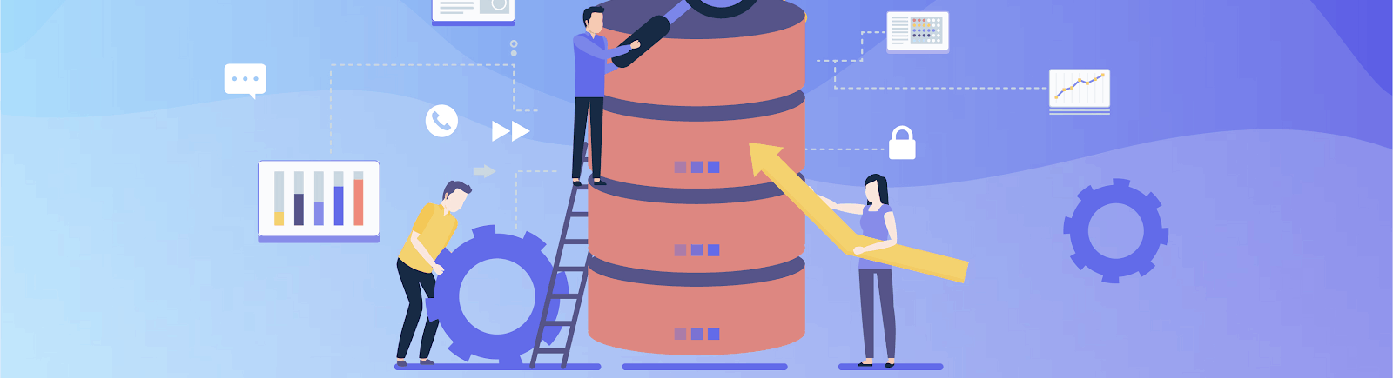
⛔️PROBLEM🚫: I never see any alerts and this is really boring
✨SOLUTION✨
Identify whether you’ll get more value out of a SIEM that is full of endpoint logs rather than a database audit.

Slide 9

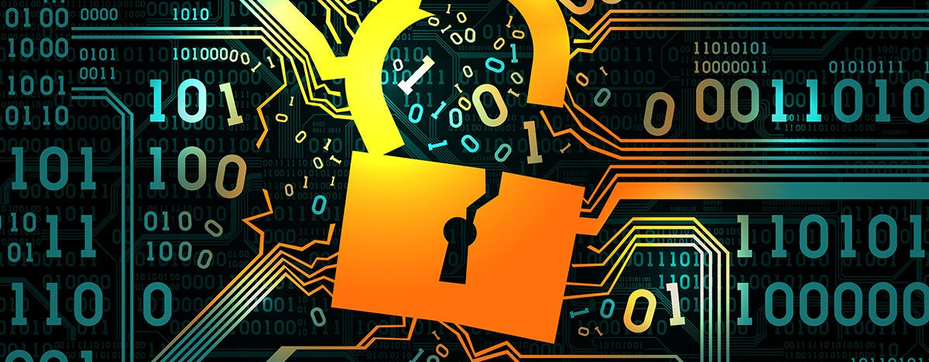
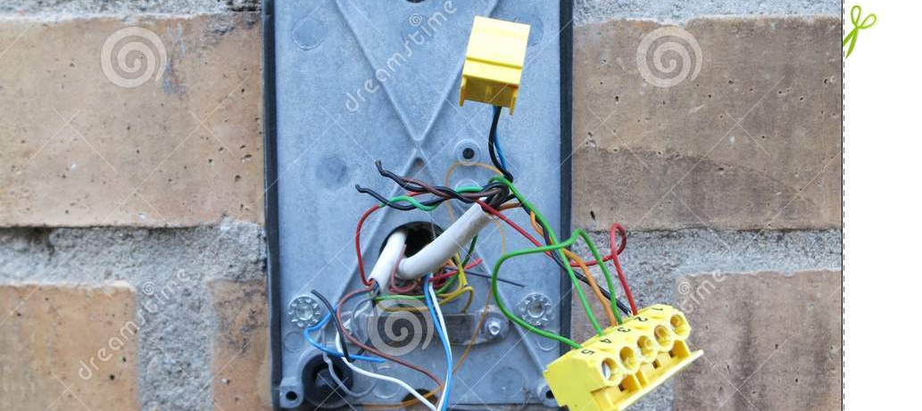
🙉PROBLEM🙈: Things break and nobody fixes it.
✨SOLUTION✨
Do you have a data inflow monitoring dashboard?

Slide 10
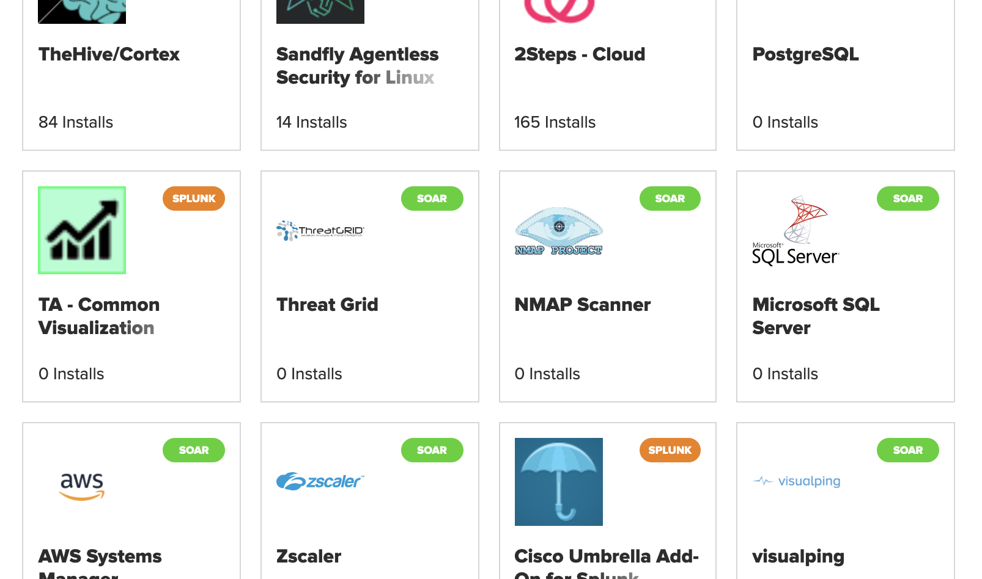
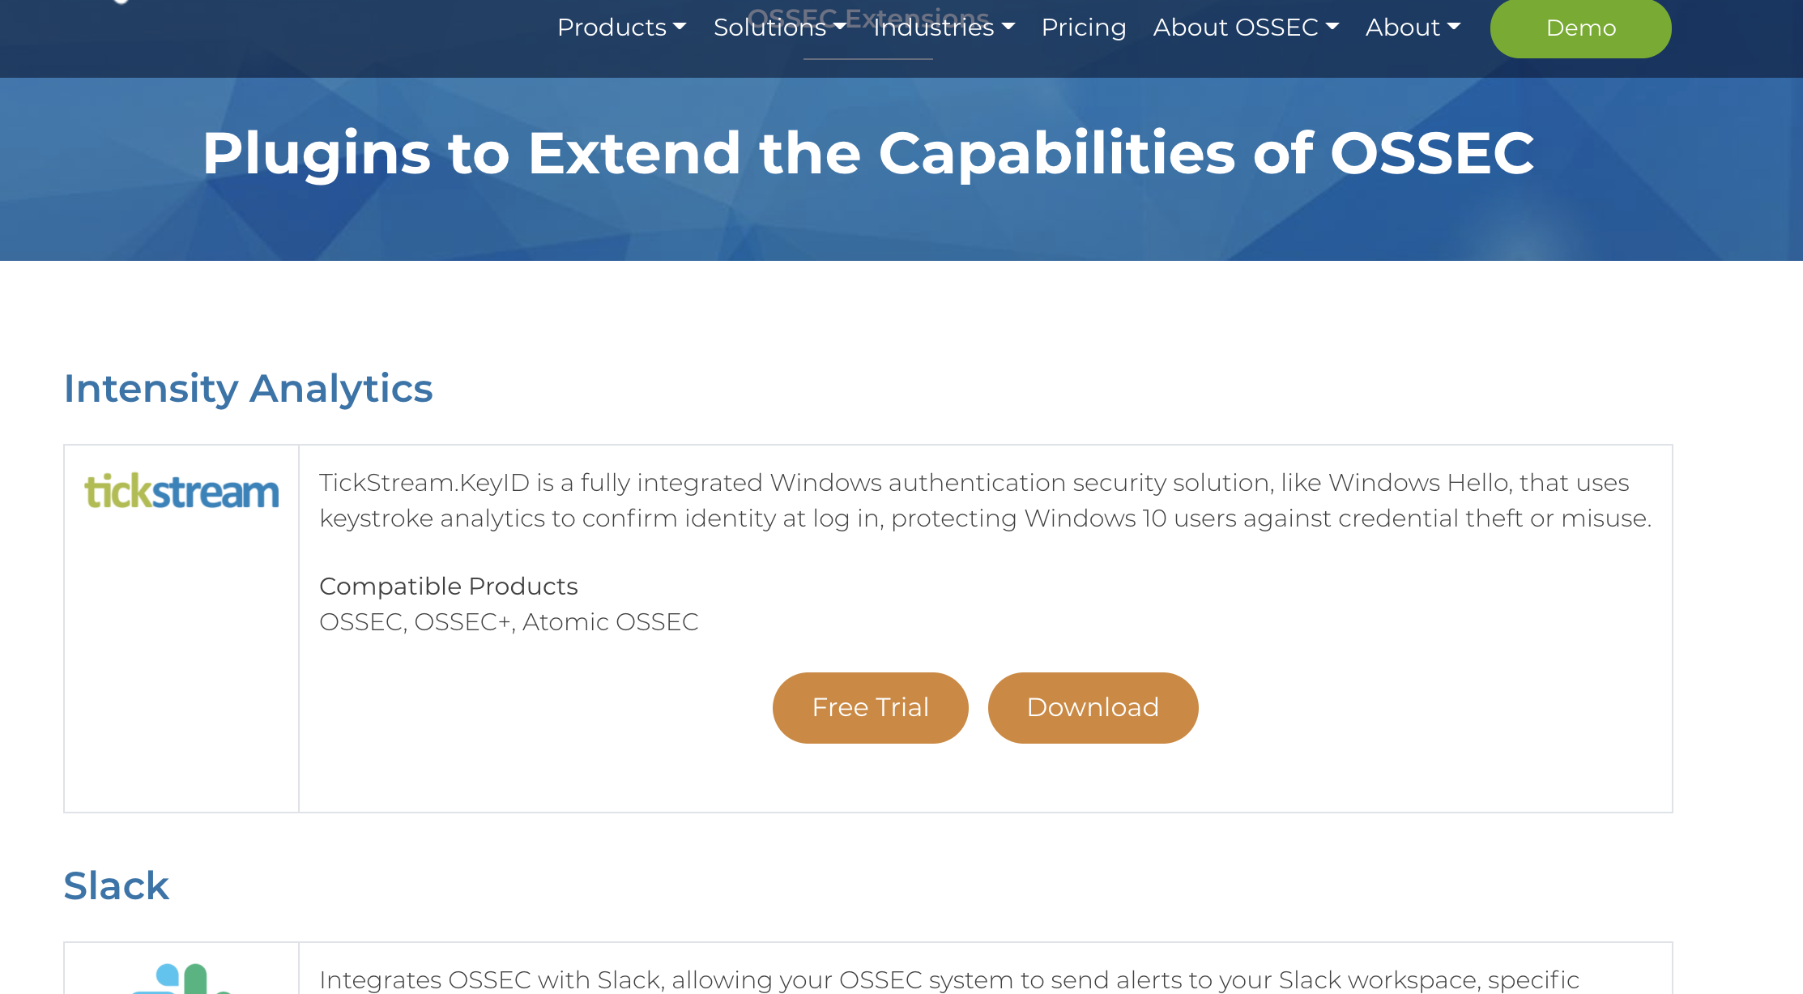
🙉PROBLEM🙈: We don’t have any plugins or I don’t know what this plugin does??
✨SOLUTION✨
Use plugins! Are any installed plugins up to date?
Make your own plugins!

Slide 11
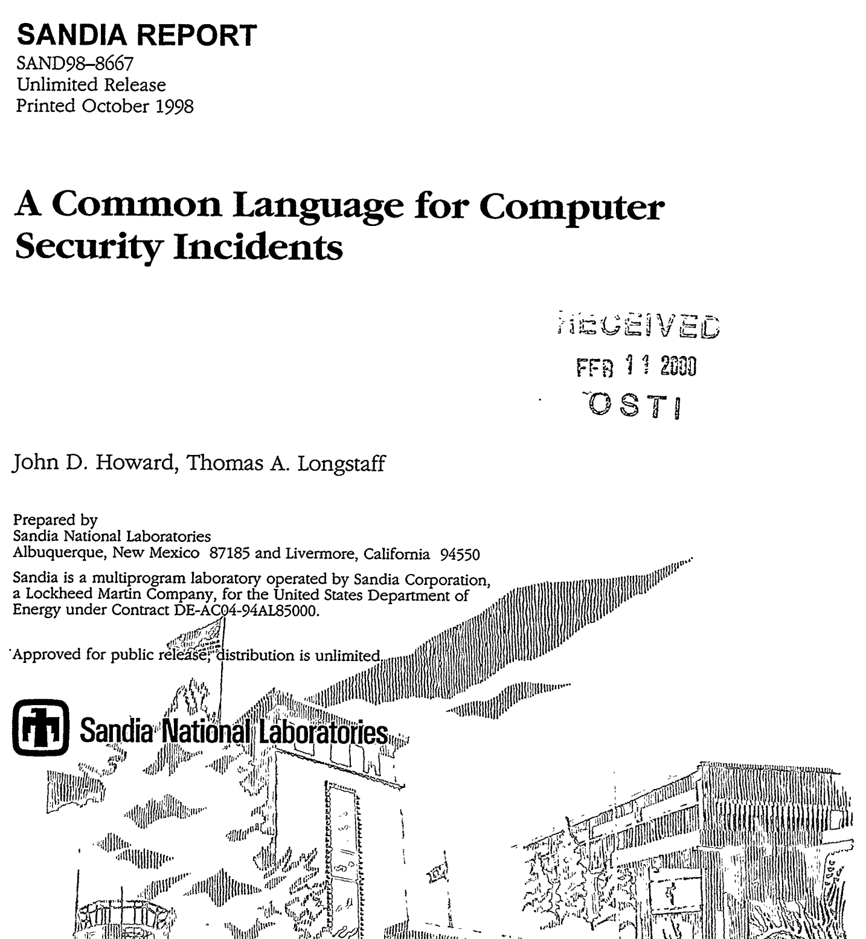
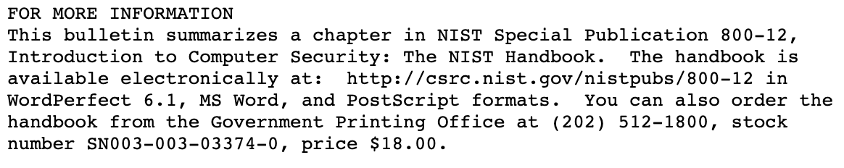
☞ know your history 🧐
to know where we are going 🚐
The concept of a SIEM comes from the requirement and language of Audit trails
“keystroke logging”??? yikes
“an event record should specify when the event occurred, the user ID associated with the event, the program or command used to initiate the event, and the result. “

Slide 12
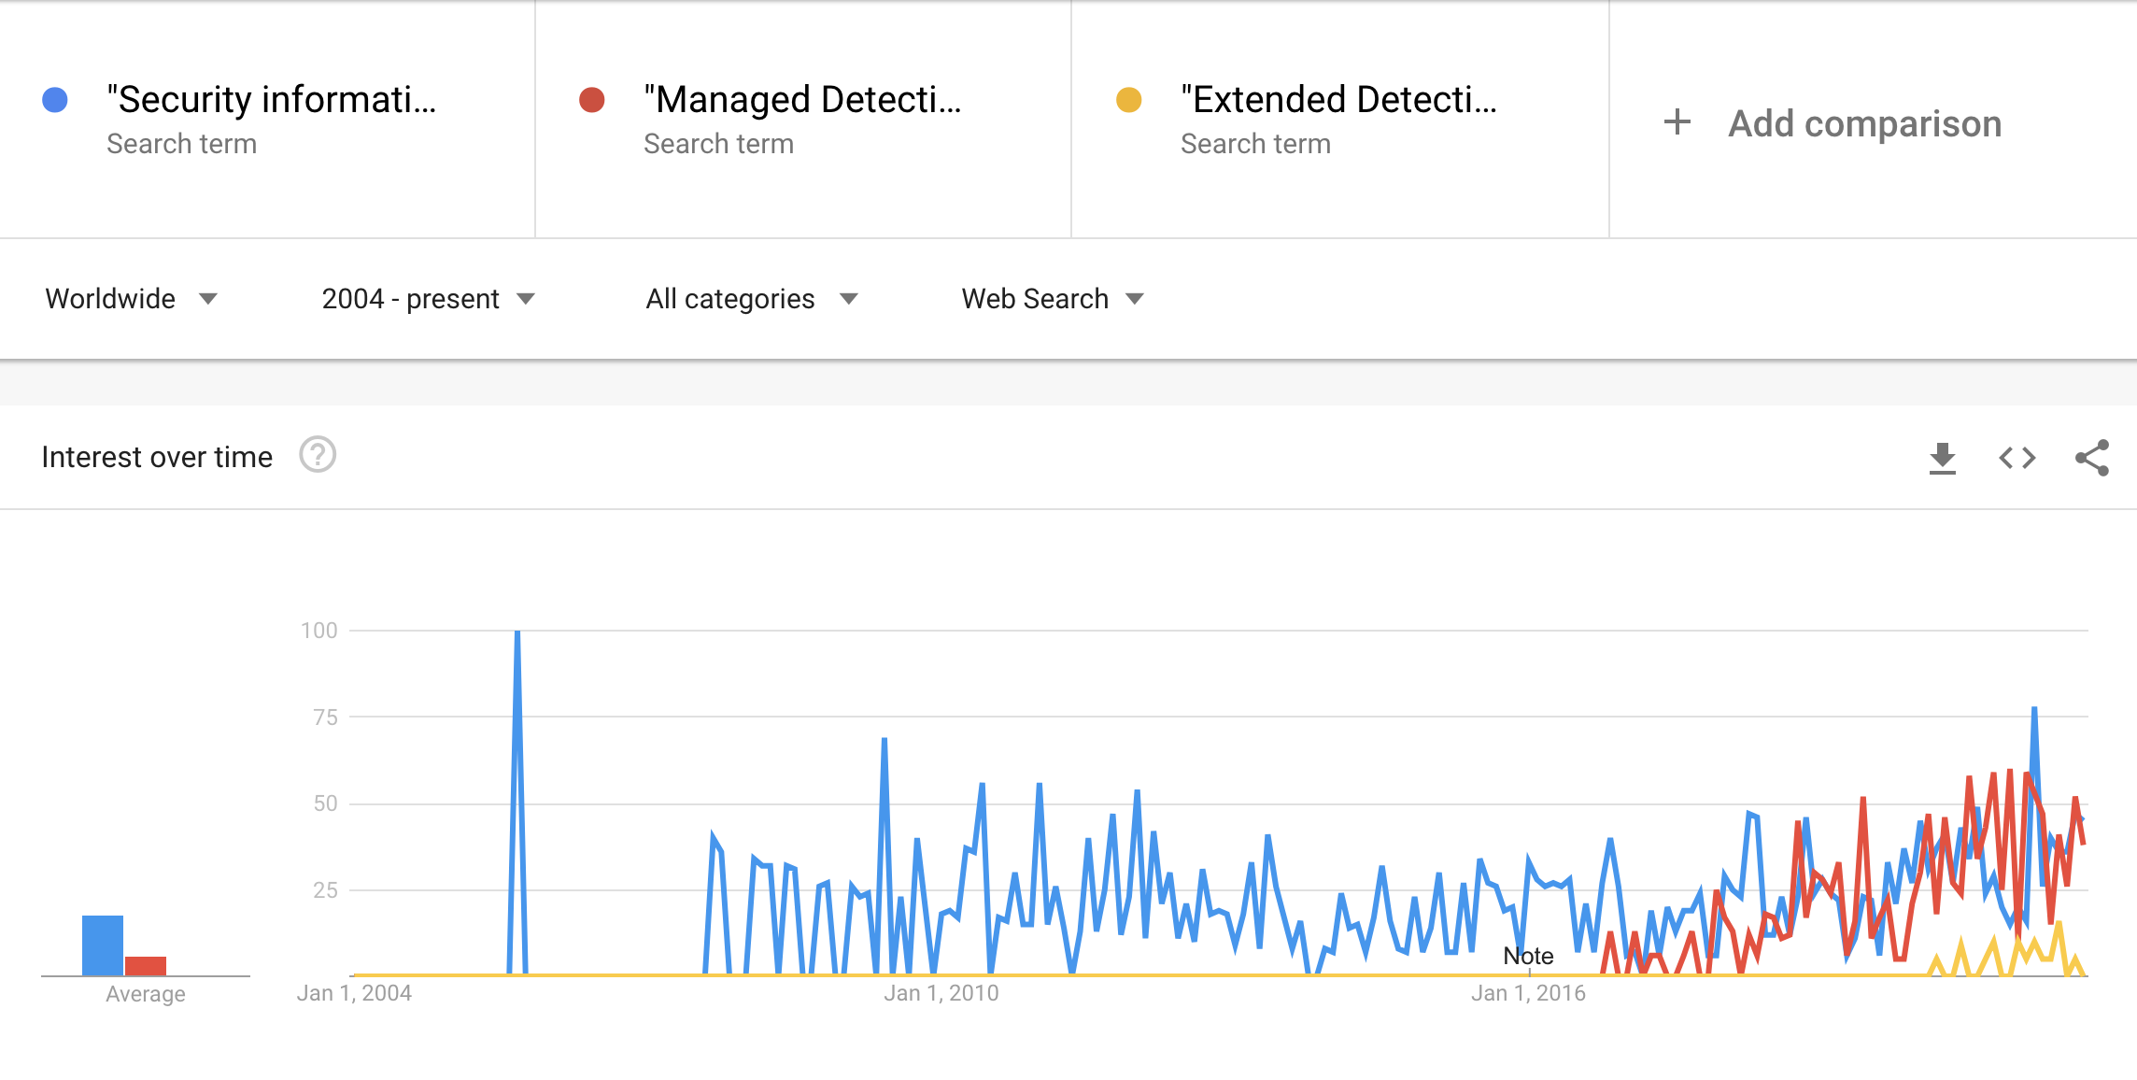
💫 the future is now ✨

Slide 13
💾
save your SIEM by moving it from a team member to a concept in the next evolution.
thanks!
❤️ kimber
twitter: @kimb3r__
website: https://ber.kim

